Slide 1
Open Science 201: Research Life Cycle from Various Stakeholder Perspectives

Slide 2
Open Scholarship
Researcher: Implementation State
Matt Makel, PhD
Johns Hopkins University
@mattmakel

Slide 3
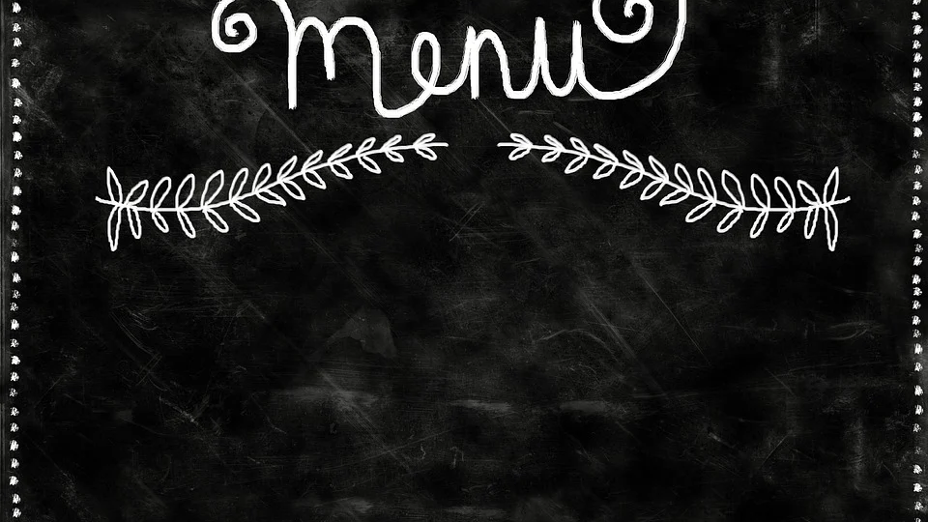
My Origin Story
Define Relevant Terms
Tips of the Trade
Expected Challenges
Tools to Get Started

Slide 4

My Open Scholarship Origin Story

Slide 5
Open Practices
Preregistration | Commit to plans before interacting with data
Registered Reports | Peer review prior interacting with data
Open Materials | Default sharing code, surveys, etc.
Open Data | Sharing data when possible
Replication | Test generalizability and repeatability of results
Open Access/Preprint | Unrestricted public access to manuscripts

Slide 6
Tips of the Trade
Try something
Don’t reinvent the wheel
Remember rewards
Save time, Shift time
Not just for quantitative work

Slide 7

Expected Challenges
1. Learning Curve
2. Hesitant Collaborators
3. Cultural Norms

Slide 8
Open Scholarship Tools
Awareness Preregistration | https://forrt.org/ https://osf.io/zab38/wiki/home/
Registered Reports | https://www.cos.io/initiatives/registered-reports
Open Materials | https://help.osf.io/article/342-getting-started-on-the-osf
Open Data | https://www.ldbase.org/
Replication | https://ies.ed.gov/pdf/CompanionGuidelinesReplicationReproducibility.pdf
Open Access/Preprint | edarxiv.org https://v2.sherpa.ac.uk/romeo/
Notes:
Link overload

Slide 9
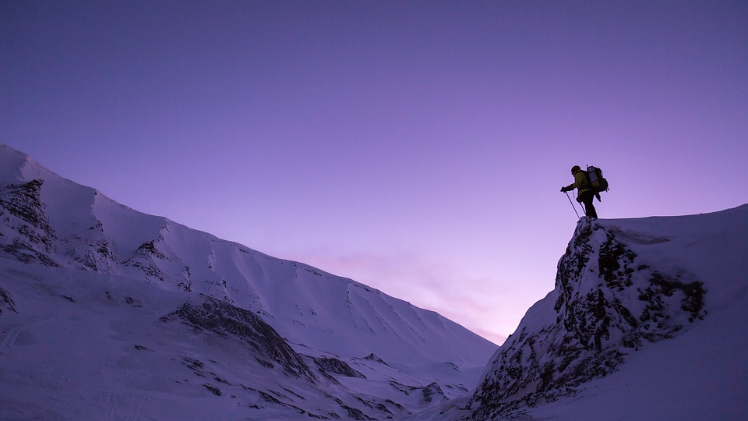
Open Scholarship:
Do what you can,
when you can.
@mattmakel

Slide 10

Open Scholarship- Methodologist Perspective
D. Betsy McCoach
University of Connecticut

Slide 11
The role of methodologists in eliminating questionable research practices (QRP)
Methodologists can help protect the integrity of the research process
Methodologists should be less likely than are substantive researchers to engage in QRPs because they do not have a high stake in finding a particular result.
Disincentive for methodologists to engage in QRPs: Methodologist’s reputation is unrelated to the findings of the study, but is integrally related to the integrity of the research process and the appropriateness of the design and analysis of the study.
If detected, a methodologist who engages in QRPs, either intentionally or unintentionally, will become a pariah within the methodological community and a less attractive research collaborator to ethical substantive researchers.
Methodologists often serve as the conscience of a research team

Slide 12

One methodologists’ Tips of the trade
Preregistration is your friend.
Be a lawyer, not an accountant.
Have a method to your modeling.
Reproducible Workflow is not enough!

Slide 13
1. Preregistration and Registered Reports can make a methodologist’s job easier!
Preregistration is an opportunity for us to be more thoughtful and planful in our research, and it forces people to think through their analyses prior to conducting the study.
Tip: Many elements of preregistration appear in IRB applications, and many IRB applications would be enhanced by including components of the pregistration. Begin the preregistration in tandem with the IRB.
Preregistration is a boon for methodologists. For far too long, researchers have “designed” studies and collected data without thoughtfully planning their analyses.
We need to think harder about our hypotheses and how to test them

Slide 14

2. Be a lawyer, not an accountant!
We should weigh the evidence that supports and refutes the hypothesis, not countp-values.
The world is not black and white. Avoid false dichotomies
Deemphasizing default tests of meaningless null hypotheses--- Does anyone care about whether a reported correlation coefficient is statistically different from 0?
Recognize the importance of measurement error.
It is much harder to be thoughtful about analyses than to revert to simplistic rules (such as statistically significant or not).

Slide 15

3. Have a method to your modeling
Apply open science principles when using modeling techniques (such as latent variable, mixture, and multilevel modeling)
Modeling techniques introduce an extraordinary number of researcher degrees of freedom.
We need defensible, coherent, logical, and reproducible systems for moving through the modeling process
SEM- Measurement Model, Just Identified Structural Model, Conceptual Model

Slide 16
4. Reproducible Workflow is not enough!
Document Everything! Not just the HOW, but the why!
Ideally, the “how” from raw data to the end product should be automated, and the “why” should be fully documented.
Methodologists can help organize and present the study design, methods, collected data, and analysis plan clearly and coherently for others to verify or to reproduce (Waldman & Lilienfeld, 2016; Wigboldus & Dotsch, 2016) and serve as additional internal reviewers to catch any issues before the data and findings are made public (Waldman & Lilienfeld, 2016).

Slide 17

Expected Challenges and Barriers
It is much harder to be thoughtful about analyses than to revert to simplistic rules (such as statistically significant or not).
Training-- we need to change the way that we train future researchers– more on that from Crystal N. Steltenpohl
There is often a tension between technical and conceptual aspects of methods-related research.
Where is the boundary between exploratory and confirmatory research… really?

Slide 18
Educator Perspective
Crystal N. Steltenpohl
Dartmouth Center for Program Design and Evaluation
@CrystalNSYoung

Slide 19

Why teach open science?
Instills values around transparency, rigor, credibility
Helps students to build critical thinking skills
Students will be knowledge consumers and creators
More employers are looking for these skills

Slide 20

Getting started
Think about how to meet student learning objectives
Think about how to integrate critical perspectives
Focus on small steps – teaching is an iterative process
Remember you don’t have to recreate the wheel

Slide 21

Common challenges and solutions
Staying clear about what open science is and isn’t
Determining the level at which material is covered
Maintaining hope about the state/future of science
Maintaining critical eye about open science initiatives
Staying abreast of current discussions, burnout

Slide 22
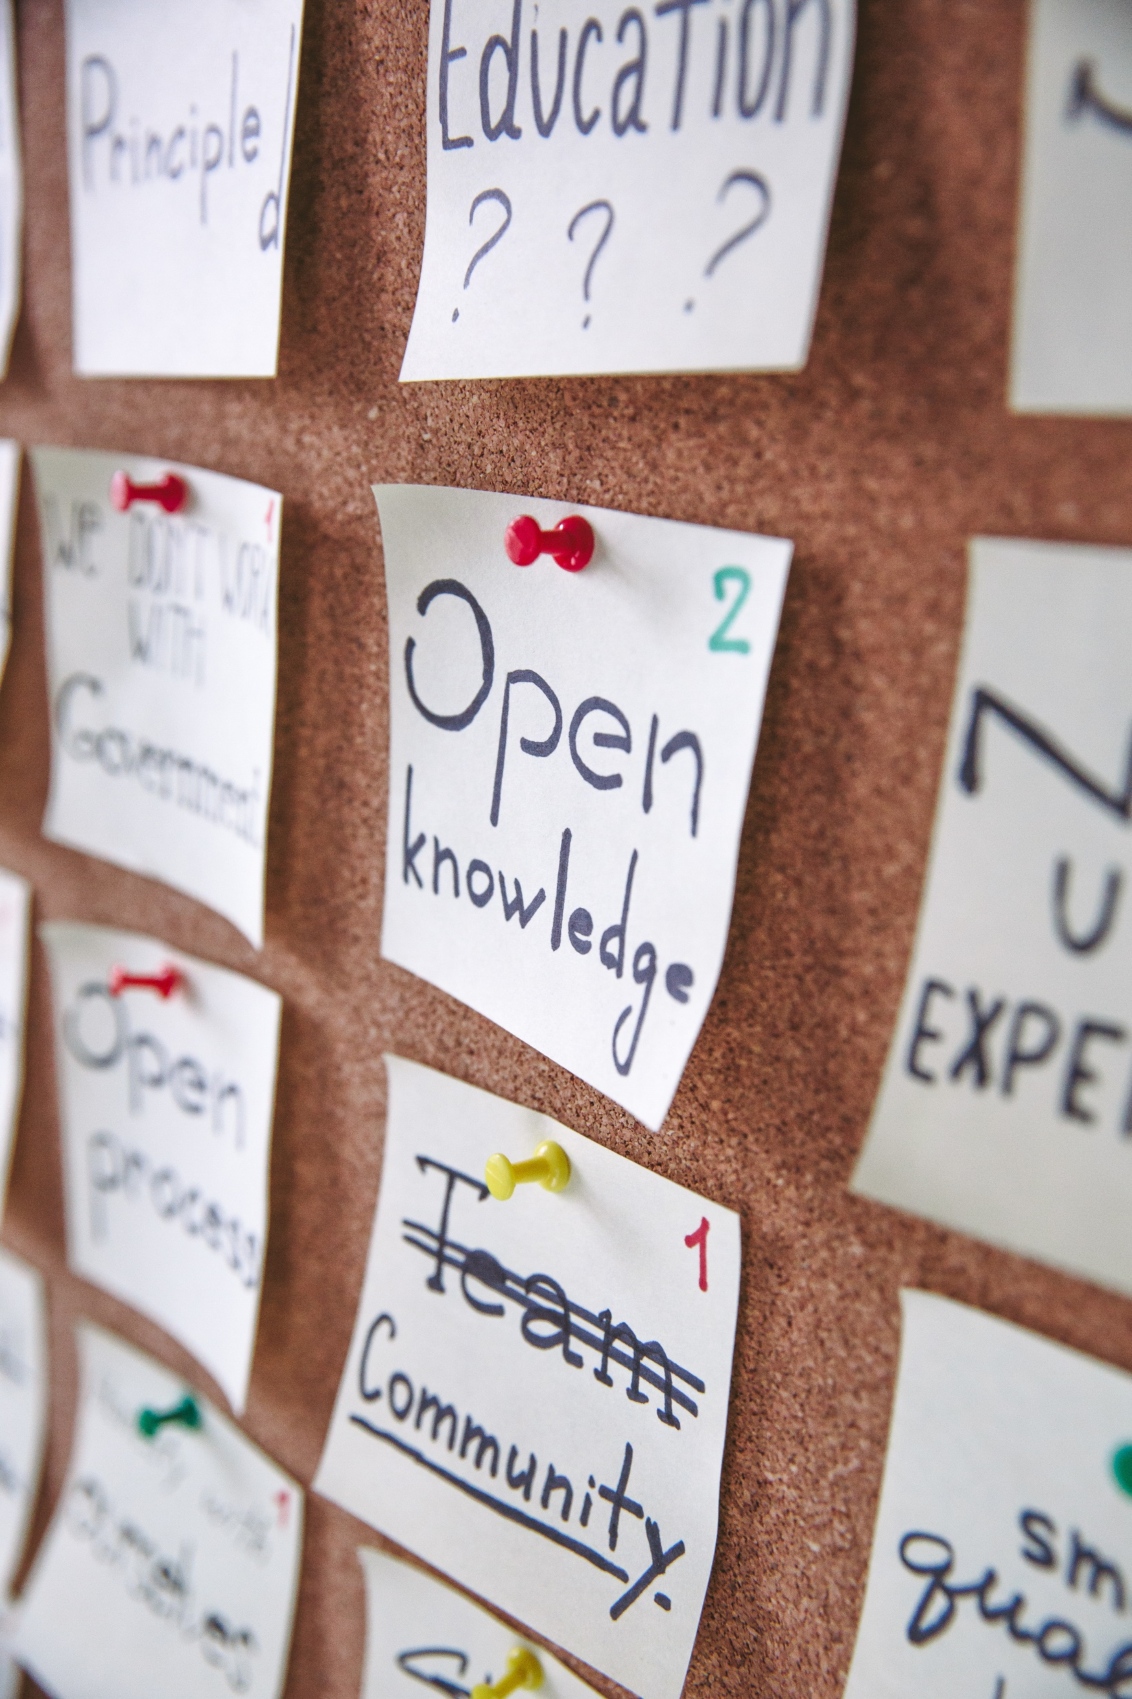
Finding community
Twitter
Facebook
Open Scholarship Knowledge Base
Society for the Improvement of Psychological Science
Librarians

Slide 23
Journal Editor Perspective
Jill Adelson and Michael S. Matthews
Gift Child Quarterly Co-Editors

Slide 24

Co-Editors: Jill Adelson and Michael S. Matthews
GCQuarterly@gmail.com

Slide 25
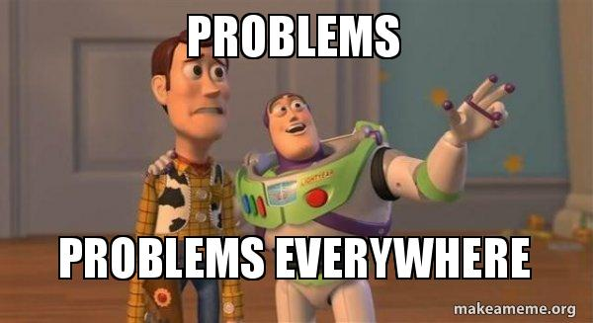
First Steps: Getting the Editorial Board on Board
Notes:
First EB meeting introduced what we were considering
First registered report already being piloted
Considering open science badges
Reaction was for a few EB members to see problems everywhere. They kept pointing out the potential problems with Open Science.
Created 2 working committees
Badges (included those most vocal about the problems and those most vocal in support)
Transparency (former editors)

Slide 26

Transparency and Openness Promotion (TOP) Guidelines https://www.cos.io/initiatives/top-guidelines
Organization signatory
Journal signatory
Commitment to at least Level I in all areas
Level II in most areas

Slide 27
TOP Guidelines
Data, Analytic Methods (Code), and Research Materials Transparency
Article states whether data, code, and materials are available, and, if so, where to access them.
Preregistration of Study and Analysis Plan
Article states whether a preregistration of the study exists; whether the analysis plan was with it; and if so, where to access it.
Citation Standards
Journal describes citation of data in guidelines to authors with clear rules and examples.
Design & Analysis Transparency
Journal articulates design transparency standards
We include dates of initial submission, final revision, and acceptance on all published articles
Replication
(Level III) Journal uses Registered Reports as a submission option for replication studies with peer review prior to observing the study outcomes.
Notes:
Some examples of changes we made right away
Every article has a statement about whether data, code, and materials are available and if the study or analysis plan were preregistered.
Our guidelines require citation of data.
We added dates of initial submission, final revision, and acceptance on all published articles.
We accept Registered Reports as an option for replication studies.

Slide 28
Four Types of Submissions
Feature Articles
Methods Briefs
Brief Reports of Research
Registered Reports
Notes:
We added 3 types of submission in addition to our feature articles. In particular, to address our commitment to open science and transparency, we added registered reports and also added research brief reports as a place to encourage replication articles.

Slide 29
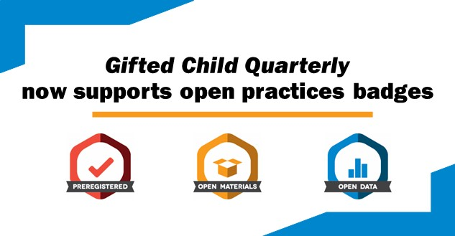
Notes:
To communicate clearly to our readers when articles have implemented specific open science practices, GCQ now offers up to three open science badges, which are small icons that will appear on the title page of published articles and next to the titles of articles on the SAGE webpage.
For the reader, the presence of these badges indicates that “key aspects of the evidence supporting the paper’s arguments are independently verifiable” (McBee et al., 2018, p. 384).

Slide 30
Challenges We’ve Faced
Registered report submissions
Getting submissions
Society buy-in
Manuscripts meeting badge criteria
Online manuscript submission and review system
Frequent personnel changes in Production role
Transition to new editors
Notes:
Getting authors to submit RRs! We’d love to have more registered reports and for more articles to meet the badge criteria.
Society was not willing to support a proposal to have a fund to support a special issue of registered reports on an important topic in our field
Getting authors to submit manuscripts that meet badge criteria
We’ve had some issues with working within the online manuscript submission and review system. It’s been clunky and was not designed for gathering the information needed for open science and transparency issues.
We’ve also had some issues with changes in personnel and them not understanding or realizing what we’ve been doing
As editors of a society-owned journal, we had no influence on who the next editorial team will be or how open and committed they will be toward open science and transparency.
No mention of Open Science on the call for new editors
New editor doesn’t have experience with open science

Slide 31
Tips of the Trade …Learn from our experience!
Get buy-in early
Be bold
Set goals and commitments
Spread the word (e.g., https://doi.org/10.1177/0016986218824675)
Educate reviewers
Recruit open science-savvy reviewers
Notes:
Get buy-in from Editorial Board members early in the process
then be bold – sometimes you have to go all-in, especially if you have a term-limited appointment within which to make positive changes occur.
Set goals and commitments – TOP Guidelines are a useful tool for demonstrating how your efforts fit within the broader open science movement.
Spread the word through conferences and social media.
Educate reviewers about any procedural differences as manuscripts with open science practices come in
talk with interested colleagues to recruit a pool of open science-savvy reviewers for these manuscripts. Choose these reviewers with care and modify the invitation letter as needed (i.e., for Registered Reports)

Slide 32
Reviewer Perspective
Erin M. Buchanan, Ph.D.
Harrisburg University of Science and Technology
@aggieerin

Slide 33
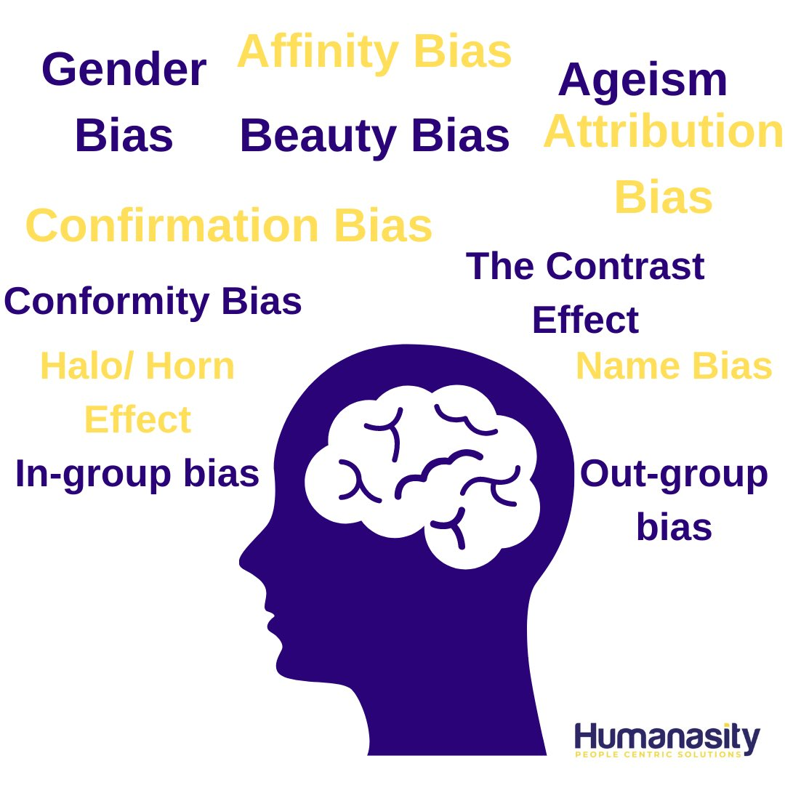
Agreeing to Peer Review
Researcher bias
Research topic bias
Open science bias
Notes:
Controlling for bias:
Unconscious bias that happens when we think there’s a specific gender/race/etc in the publication
Conscious bias against a specific field or area
Both when reviewing something you may have seen on twitter or in a preprint

Slide 34

Agreeing to Peer Review
Open Peer Review
Signed Review
Open Reports
Open Participation
Notes:
Peer review is often shrouded in secrecy, but is the newest avenue for the open science community to tackle transparency (Wolfram et al., 2020). Open peer review can consist of signed reviews (i.e., the reviewer gives their name), open reports (i.e., the publication of the peer review with the published article), or open participation (i.e., open commentary on published articles through services like hypothes.is).
What is open peer review?
Open peer review varies by journal
Can range on a scale from no one knows who anyone is to all comments/replies/etc are all published with the article
You should know if you are comfortable signing your own reviews
Know what the journal rules are before agreeing

Slide 35
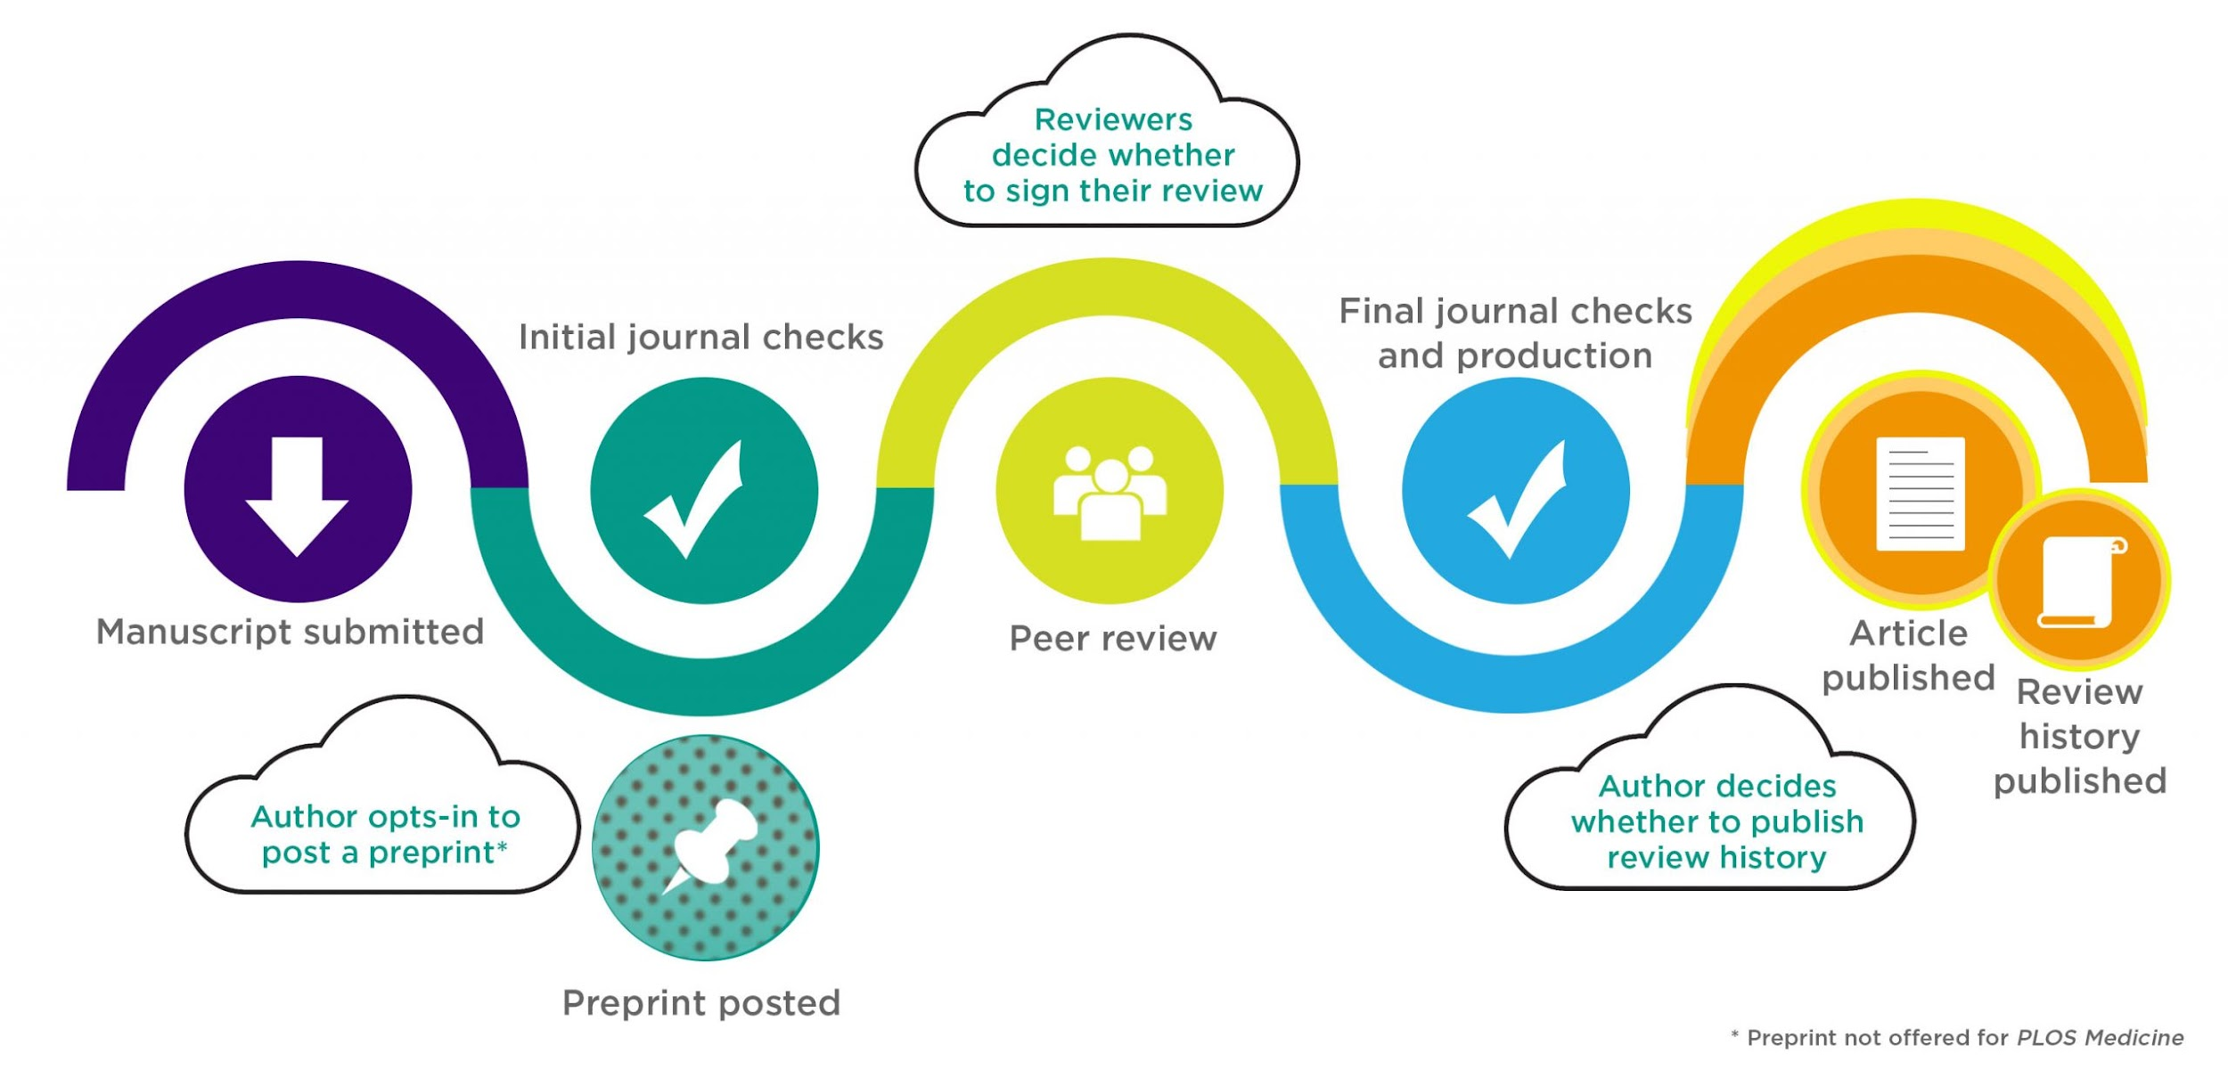
Notes:
This is an example of how PLOS one currently handles open peer review.
Meta psychology is an open access journal that takes a similar stance, however, all parts are required to be open.

Slide 36
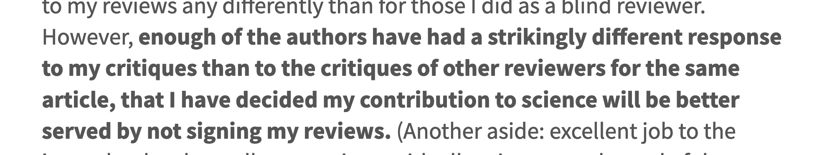

The Pitfalls of Name Signing
Notes:
In a perfect world no one would have to care, but young scientists may not have the power to do so
The time to catch the bad stuff is during peer review so we don’t have horror stories about post publication review

Slide 37
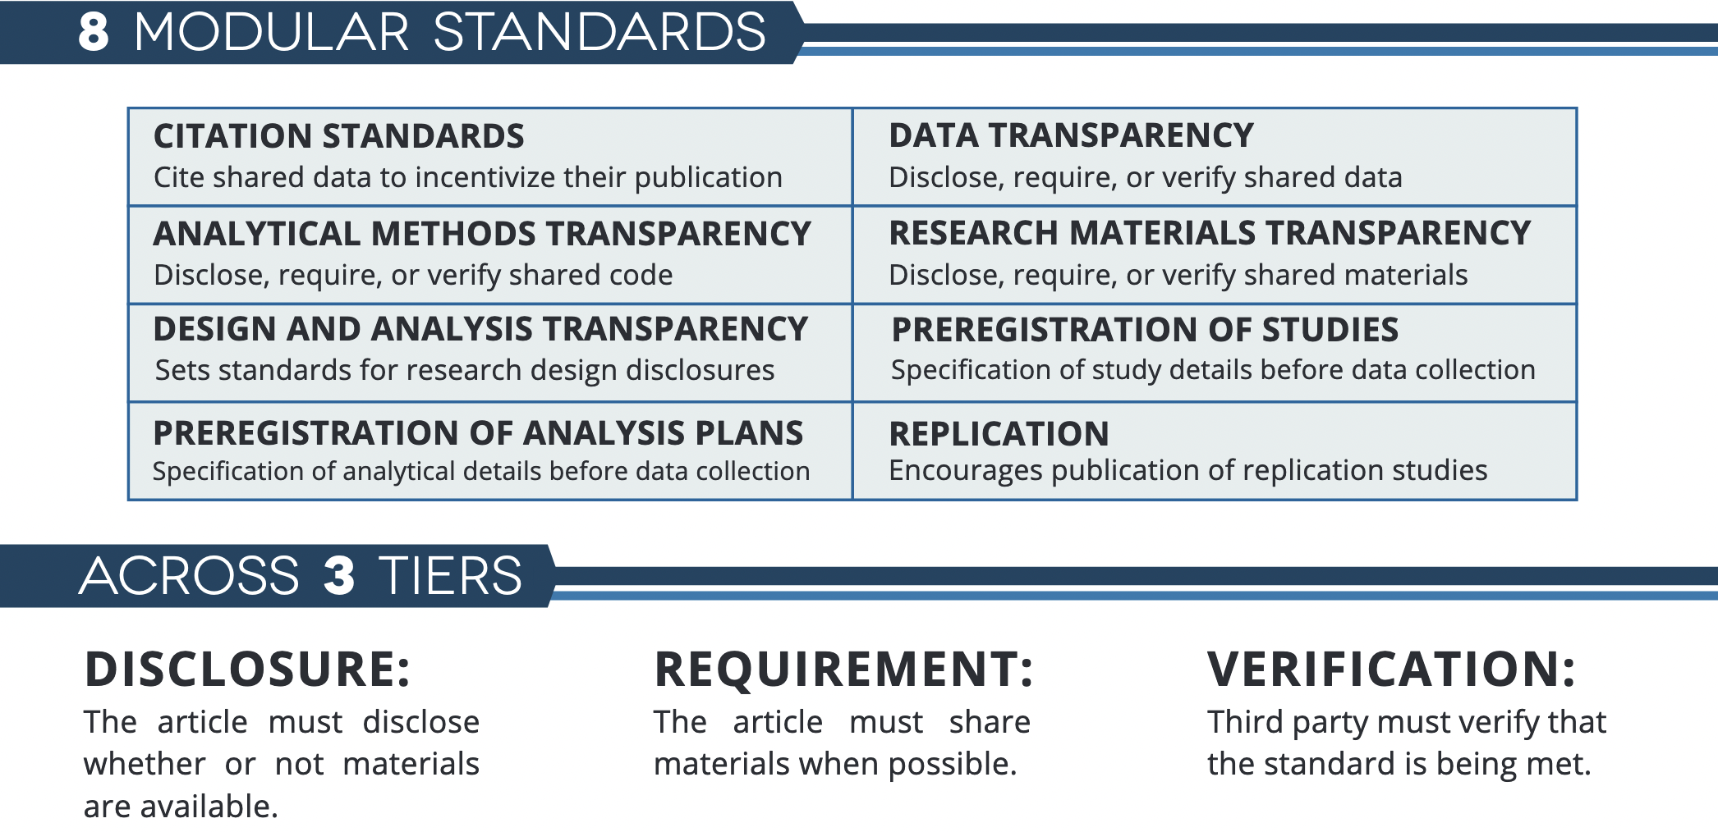
TOP Guidelines
Notes:
Open peer review practices can be daunting to researchers, especially early career academics who do not want to “make waves” in their scientific community.
Requesting authors to follow TOP guidelines may be difficult without journal support.
Not all reviewers will feel comfortable checking all parts of the manuscript, and authors may not respond when asked (i.e., data, scripts, etc.).
Journals should give TOP structured templates to reviewers to help guide reviews.
Start small by encouraging, but not requiring open review, and the normalization of this process will promote its use.
Incentivize reviewing. Peer review can be published alongside the article with a citable DOI to encourage open practices and reward effort that is currently underappreciated.
Useful for authors knowing what to report
Useful for journals to ensure quality work
(Currently) hard for reviewers

Slide 38
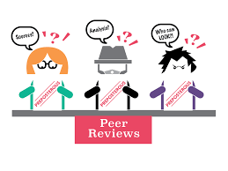
Final Thoughts
Start small
Make peer review easier
Incentivize peer review
Notes:
Journals should give TOP structured templates to reviewers to help guide reviews.
Start small by encouraging, but not requiring open review, and the normalization of this process will promote its use.
Incentivize reviewing. Peer review can be published alongside the article with a citable DOI to encourage open practices and reward effort that is currently underappreciated.

